Slide 1
PebbleX
Presented By :
Anish Baniya Gaurav Ghimire
Prajal Gurung

Slide 2
Introduction
PebbleX is a web and mobile platform for hardware suppliers and vendors to manage and place orders.
It connects suppliers and vendors in tools, electrical, and construction materials.
Built for Nepal, it boosts productivity and reduces manual work.

Slide 3
Background Study
Hamro Nirman
Hamro Nirman is the first and one of the largest e-commerce platforms in the
construction sector of Nepal.
Ghar Banau
Ghar Banau, on the other hand, operates as an online marketplace focused on enabling
buyers and sellers of construction materials to directly connect and transact.

Slide 4
Problem Statement
Limited adoption of real-time inventory tracking and automated ordering.
Lack of centralized inventory management for suppliers.

Slide 5
Objectives
To improve supply chain efficiency by automating workflows.
To develop a centralized web platform for suppliers to manage inventory, pricing,
and vendor orders.
To provide a vendor with a mobile application for bulk ordering as well as other services.

Slide 6
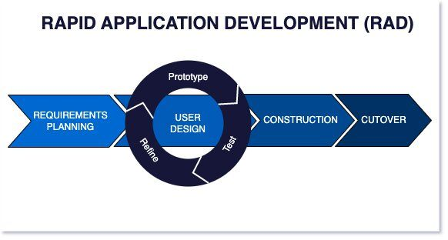
Methodology

Slide 7
Gantt Chart

Slide 8
Thank You !
- PebbleX

